Slide 1
Reception Parent Meeting
September 2022
Mrs Pryor – Acting Head of School
Miss Woodward – Class 1 teacher

Slide 2
Aims:
Our school
Teaching and learning (EYFS framework)
Baseline
Tapestry
Website and Twitter
Phonics
Reading books
Forest School and Physical Development
Our church and Worship
Home School Communication
Questions

Slide 3
Our School
Our School Vision
A school family at the center of its village community, with a big outward looking heart, where all are enabled to shine as unique individuals, using their well of abilities to flourish as global citizens. (Isaiah 58:11)
At Longborough Primary School we show LOVE, have PRIDE and are SAFE.
Our Christian Values
Compassion - Clothe yourselves with compassion, kindness, humility, gentleness and patience. Colossians 3.12
Courage - Be strong and courageous; do not be frightened or dismayed, for the lord your God is with you wherever you go. Joshua 1.9
Respect - Do to others as you would have them do to you. Matthew 7.12

Slide 4
Teaching and Learning
Our aim is to make the learning as practical, fun and engaging. We will be outside in all weathers so we might get a little messy!
Teaching and learning will take place through adult led activities/teaching and through child-initiated exploration.
The classroom is set up for child-led continuous provision which is enhanced to link with our phonics, English, Maths and topic themes as well as the children’s interests and needs.
As a C of E School we have weekly RE lessons, alongside regular collective worship.

Slide 5
EYFS Framework
The EYFS framework sets the welfare requirements and the 7 areas of learning and development from birth until the end of the reception year.
In the 7 areas there are 17 Early Learning Goals which we aim to achieve by the end of the year.
At the end of the year your child will receive a school report which will detail your child’s progress against the 17 Early learning Goals.
If we have any concerns over the year, we will involve you with what we are going to put in place to support your child and discuss how you can support from home.

Slide 6
EYFS Baseline
We will be taking part in the EYFS baseline from the Department of Education.
We aim to complete the baseline during the first full week of school in September.
The baseline will be completed on a 1:1 basis.
There will be practical and visual activities which focus on Maths and English skills.
We will share with you the narrative statements produced by the baseline about the children, which is the new way to measure progress in primary school.

Slide 7
Tapestry
Observations will be added including photos and videos to make up you child’s learning journey.
If you wanted to share something special that your child has done at home, you can upload it to Tapestry for us to see!
If you wish to add any other people to Tapestry to view your child’s learning journey please send an email to the office.

Slide 8
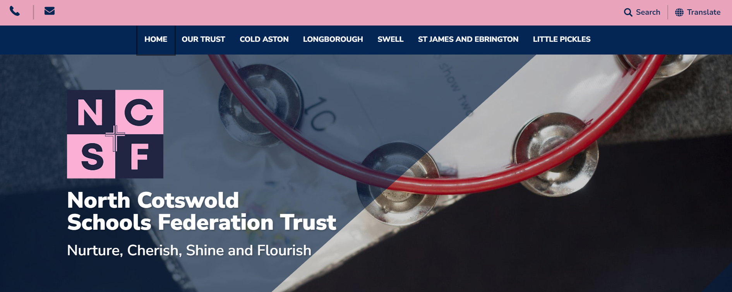
Website and Twitter
Information about our school and learning can be found on our website.
Pictures of our adventures can be found on the class pages of the website.
https://www.northcotswoldschools.co.uk/
Follow us on Twitter for regular updates!
@CotsNorth @LongboroughCofE

Slide 9
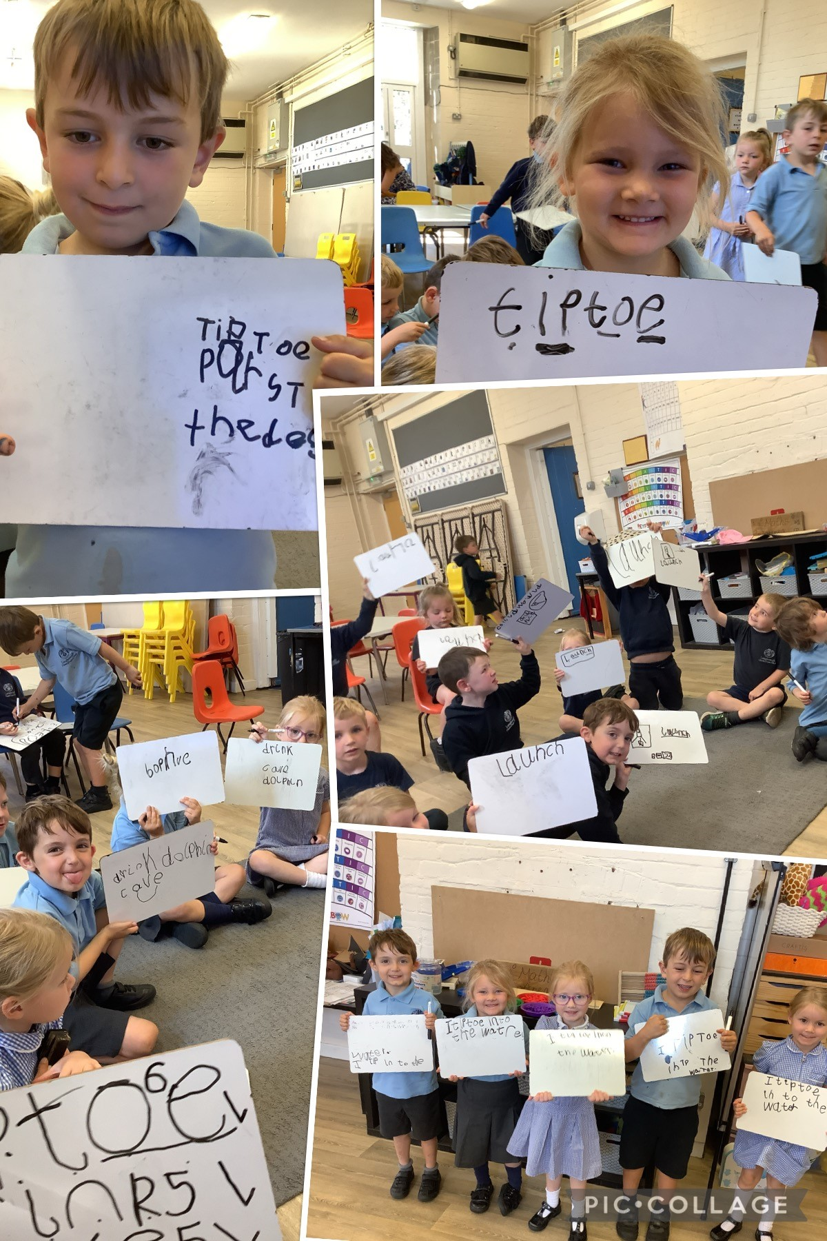
Phonics homework
Flip book – please be careful with your pronunciation! https://www.youtube.com/watch?v=TTe5_Em0BHQ
Harder to read and spell (HRS) words
High frequency words
5 minutes per day

Slide 10
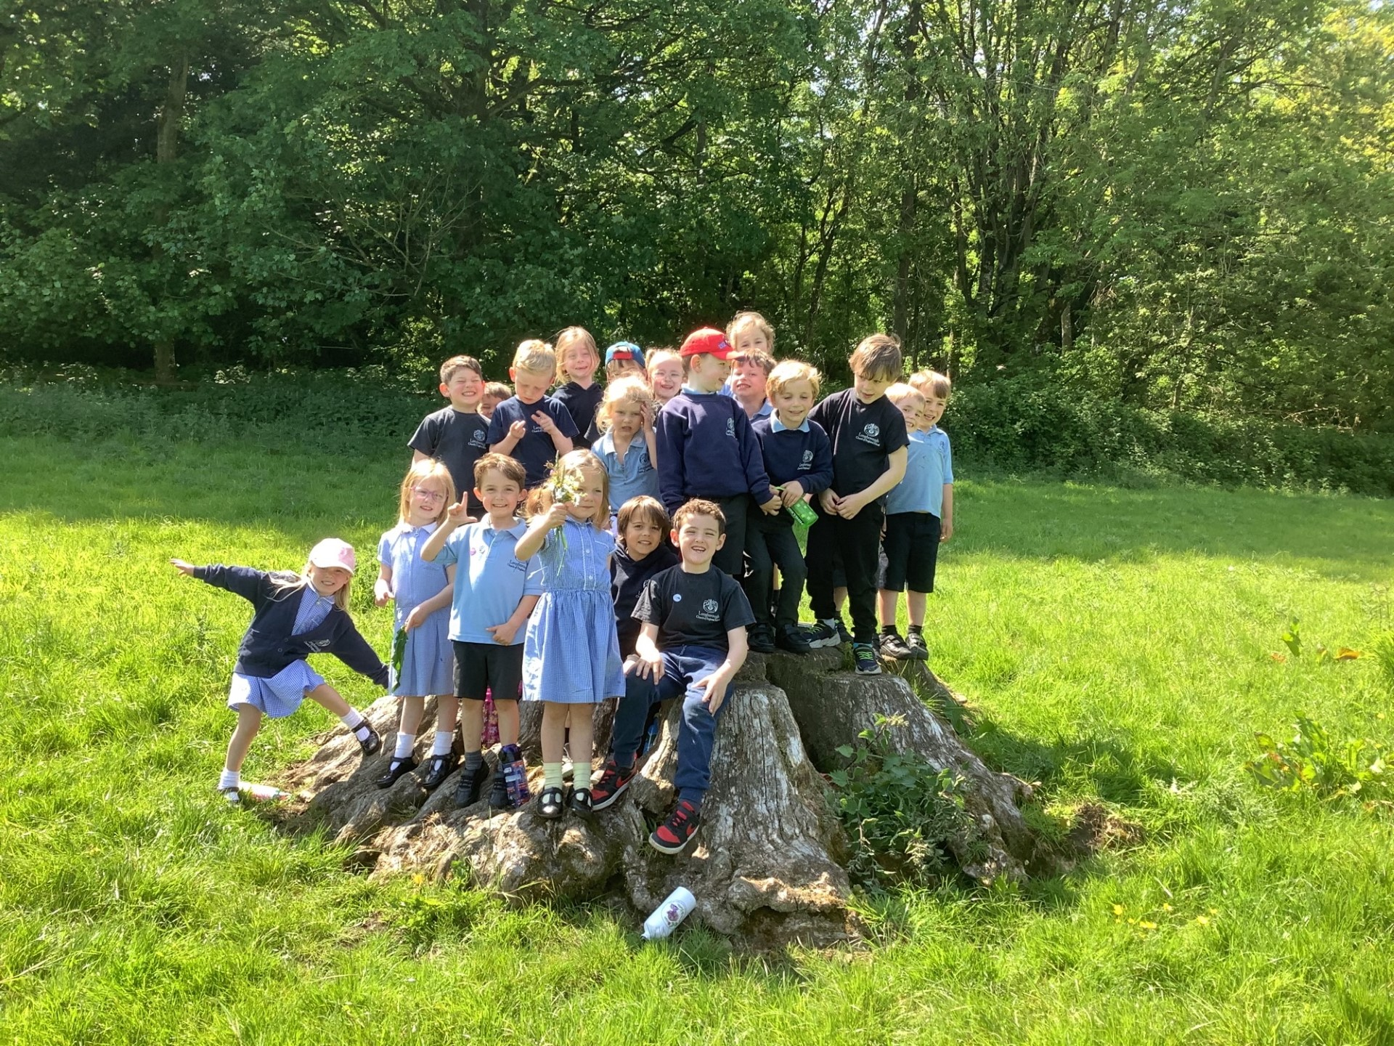
Forest Friday
Forest Friday takes place every Friday afternoon.
Please send your child with a warm jumper and joggers.
We provide waterproof suits.
In winter send extra layers eg. fleece, gloves and a hat. NAMED!
Please ensure your child has a weather appropriate coat in school every day and a sun hat or woolly hat when required.

Slide 11
Physical Development
Physical development is planned for throughout our week; however, we have a specific weekly session focused on PD.
Class 1 will have PE each week with Mr Cooper from the Sports Project.
Children should keep their PE kit in school. Joggers will be needed in winter.

Slide 12
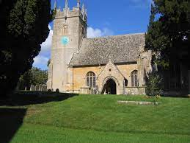
Our Church and Worship
We are a Church of England School and have strong links with our local Church – St. James' Longborough
Each day we have Worship within our classes or as a whole school
Throughout the year we celebrate different religious festivals.
Pebble Worship will take place at the beginning of term.
Harvest Festival will be around the end of September.

Slide 13
Home School Communication
If you need to get in touch with us about anything, the easiest way to do so is by:
emailing LongboroughAdmin@ncsf.school
arranging a meeting or phone call by contacting the office
or if it is a quick message or question, at drop-off or pick-up.

Slide 14
Home school agreement
Please add ‘wow moments’ and other activities to Tapestry to become part of your child’s learning journey.
Support us with getting the children to school on time and helping to settle the children in.
Please read with your child as much as possible. Try to read their reading books every night and record this in their reading record or any other stories that you have shared.
Please count aloud or count objects whenever possible. Linking to everyday tasks works well and makes this a purposeful task.

